Slide 1
Learning space modernization project
August 14, 2014

Slide 2
Tonight’s overview
WHY
WHAT
HOW
Why?
  Renovations in CIP
  Contemporary Learning Space Evaluation
What?
  Project Scope
  Project Budget
How?
  Project Schedule

Slide 3
Renovation in capital improvement program
WHY
WHAT
HOW
Historically, ACPS’s capital program consists of maintenance, technology and building addition projects.
Any major renovation work is typically completed in conjunction with an addition
Current CIP includes NO renovation or renewal cycle

Slide 4
Building age
WHY
WHAT
HOW
Age of Original Building
 |  |  |  | Woodbrook
 |  |  |  | Jouett
 |  | Meriwether Lewis | Scottsville | Henley | Murray HS
 | Sutherland | Crozet | Walton | Brownsville | Murray Elementary
 | Monticello HS | Cale | Greer | Hollymead | Yancey | Burley | Stony Point
 | Baker-Butler | Agnor-Hurt | Western Albemarle | Red Hill | Stone Robinson | Albemarle | Broadus Wood
1-10 | 11-20 | 21-30 | 31-40 | 41-50 | 51-60 | 61-70 | 71-80
# of Years

Slide 5
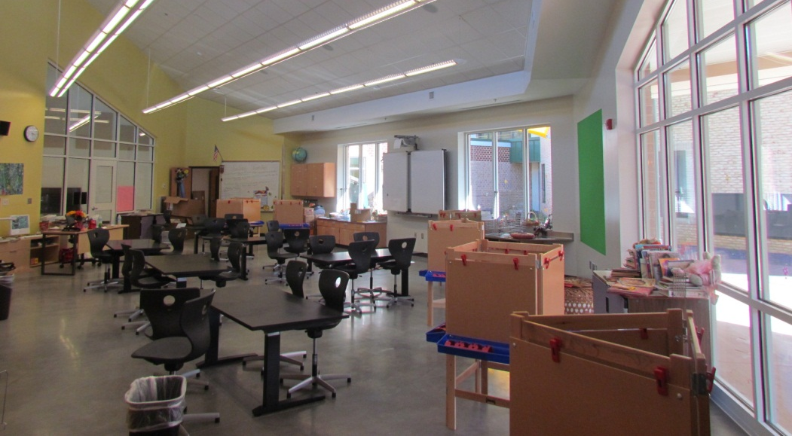
Contemporary learning space evaluation
WHY
WHAT
HOW
Evaluation completed to support :
School Board Priority 1.3
Integrate the use of contemporary learning spaces and supportive technologies into the instructional program delivery.

Slide 6
Contemporary learning space evaluation
WHY
WHAT
HOW
A contemporary learning space supports the 21st Century Student by aligning with the following guiding principles:
Transparency
Sustainability
Flexibility
Mobility/Interactivity
Making Everywhere
Problem/Project/Passion Based Learning
Choice & Comfort
Inside/Outside
“DESIGN IMPERATIVES”

Slide 7

Contemporary learning space evaluation
Supporting Research
WHY
WHAT
HOW
“A holistic, multi-level analysis identifying the impact of classroom design on pupils’ learning”
Peter Barrett, Yufan Zhang, Joanne Moffat, Khairy Kobbacy
School of the Built Environment, Maxwell Building, University of Salford, Salford M5 4WT, UK
  “The aim of this study was to explore if there is any evidence for demonstrable impacts of school building design on the learning rates of pupils in primary schools.”
  Studied 751 Pupils in 34 Classrooms at 7 schools
  The study uses multilevel statistical modeling.

Slide 8
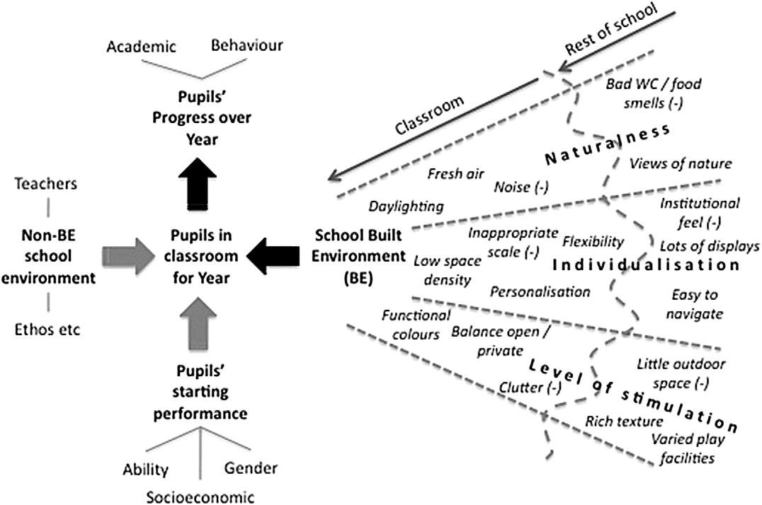
Contemporary learning space evaluation
Supporting Research
WHY
WHAT
HOW
“A holistic, multi-level analysis identifying the impact of classroom design on pupils’ learning”
Peter Barrett, Yufan Zhang, Joanne Moffat, Khairy Kobbacy
School of the Built Environment, Maxwell Building, University of Salford, Salford M5 4WT, UK

Slide 9
Contemporary learning space evaluation
Supporting Research
WHY
WHAT
HOW
Environmental factors studied:
Design Principles | Design Parameters
Naturalness | Light
 | Sound
 | Temperature
 | Air Quality
Individualism | Choice
 | Flexibility
 | Connection
Stimulation | Complexity
 | Color
 | Texture
“A holistic, multi-level analysis identifying the impact of classroom design on pupils’ learning”
Peter Barrett, Yufan Zhang, Joanne Moffat, Khairy Kobbacy
School of the Built Environment, Maxwell Building, University of Salford, Salford M5 4WT, UK

Slide 10
Contemporary learning space evaluation
Supporting Research:
WHY
WHAT
HOW
“The most distinctive classroom characteristics that relate to the improvement of the pupils’ academic achievement via the model”:
Design Principles | Design Parameters
Naturalness | Light
 | Sound
 | Temperature
 | Air Quality
Individualism | Choice
 | Flexibility
 | Connection
Stimulation | Complexity
 | Color
 | Texture
“A holistic, multi-level analysis identifying the impact of classroom design on pupils’ learning”
Peter Barrett, Yufan Zhang, Joanne Moffat, Khairy Kobbacy
School of the Built Environment, Maxwell Building, University of Salford, Salford M5 4WT, UK

Slide 11
Contemporary learning space evaluation
Supporting Research
WHY
WHAT
HOW
Key Finding:
“The impact of these environmental factors alone has also been scaled and appears to account for, in the order of, 25% of the
learning progression of pupils.”
“A holistic, multi-level analysis identifying the impact of classroom design on pupils’ learning”
Peter Barrett, Yufan Zhang, Joanne Moffat, Khairy Kobbacy
School of the Built Environment, Maxwell Building, University of Salford, Salford M5 4WT, UK

Slide 12
Contemporary learning space evaluation
WHY
WHAT
HOW
  Staff conducted a field survey of ALL classrooms in the division. Evaluation included:
Furniture
Lighting
Access to outdoors
Connectivity to other spaces
Power
Storage
Condition
Comfort
Choice
Daylighting
Lighting Control
Doors
Windows
Relationship to other classrooms, hallways, etc.
Adequacy
Accessibility
Adequacy
Availability

Slide 13
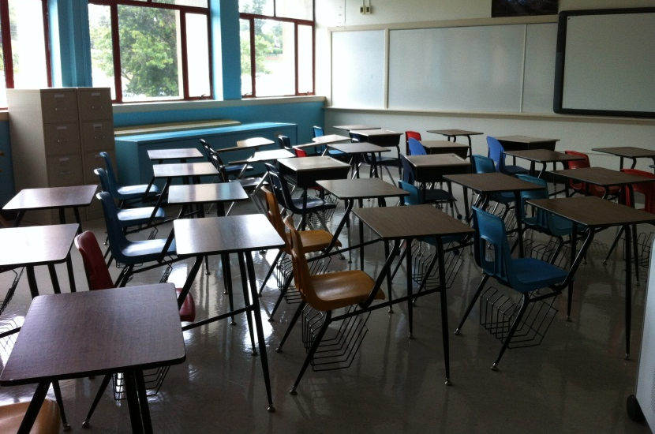
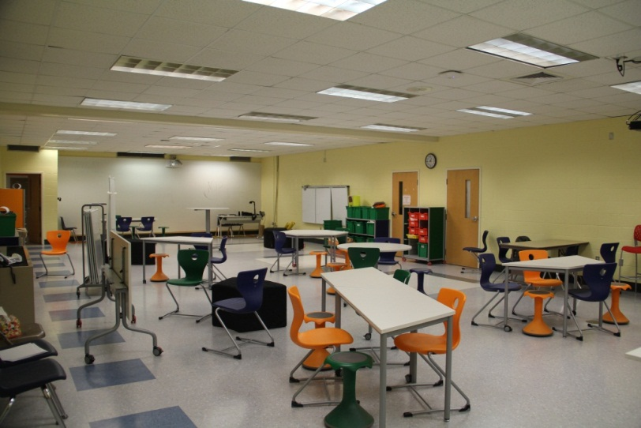
furniture
Contemporary learning space evaluation
WHY
WHAT
HOW
Why is it important?
40% of Albemarle High School Classrooms have attached chairs/desks

Slide 14
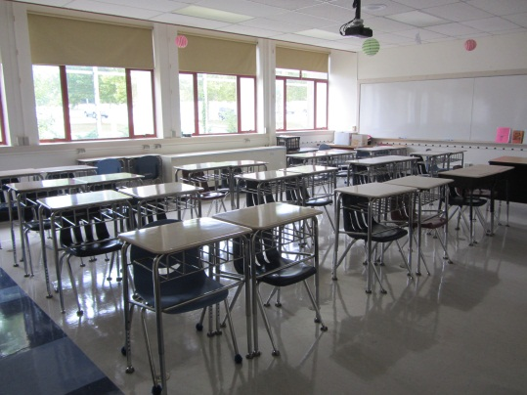
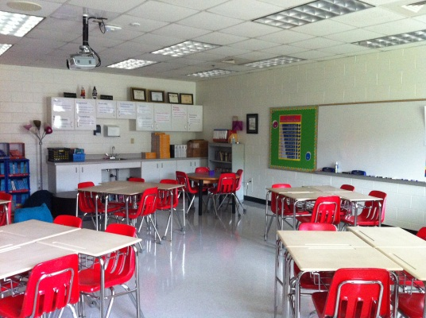
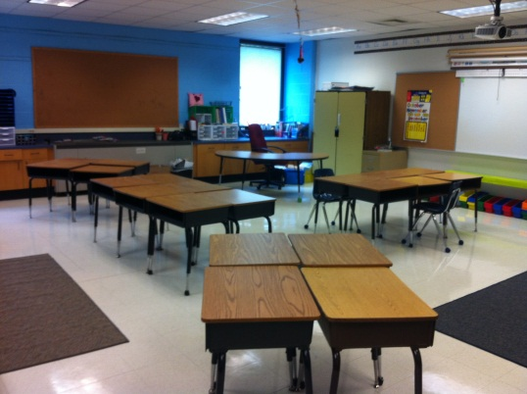
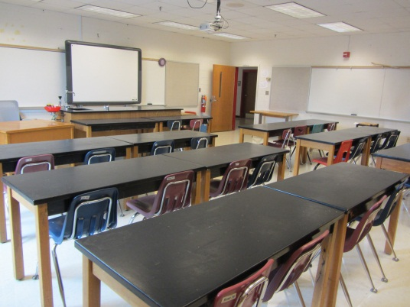
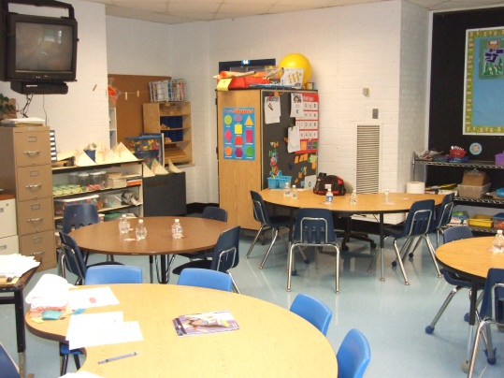
furniture
Contemporary learning space evaluation
WHY
WHAT
HOW
Examples of current furniture:

Slide 15
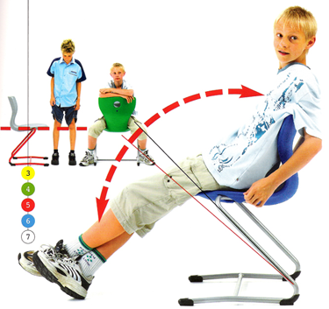
furniture
Contemporary learning space evaluation
WHY
WHAT
HOW
Comfort/Choice
Comfort/Choice Examples | Elementary | Middle | High
Soft Seating Options | 7% | 14% | 10%
Seating that Promotes Movement | 1% | 3% | 3%
Height adjustable tables/desks | 0% | 1% | 0%
A variety of seating and/or work environments | 7% | 5% | 14%

Slide 16
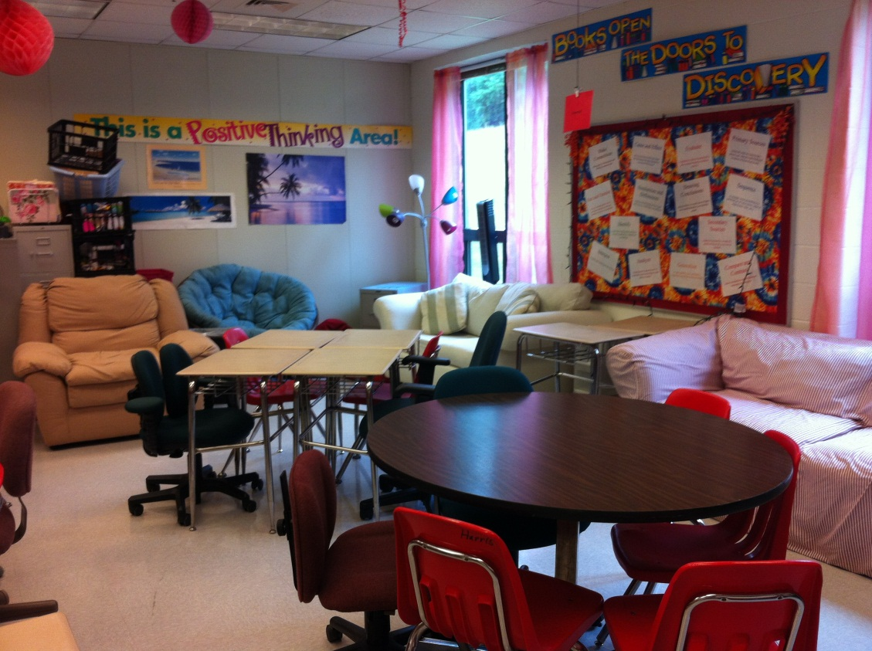
furniture
Contemporary learning space evaluation
WHY
WHAT
HOW
Comfort/Choice

Slide 17
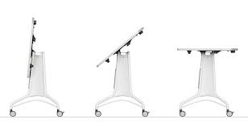
furniture
Contemporary learning space evaluation
WHY
WHAT
HOW
Flexibility
Flexible Furniture Examples | Elementary | Middle | High
Tables/desks on casters | 2% | 0% | 4%
Flip-top Tables | 1% | 0% | 2%
Chairs on casters | 0% | 0% | <1%

Slide 18
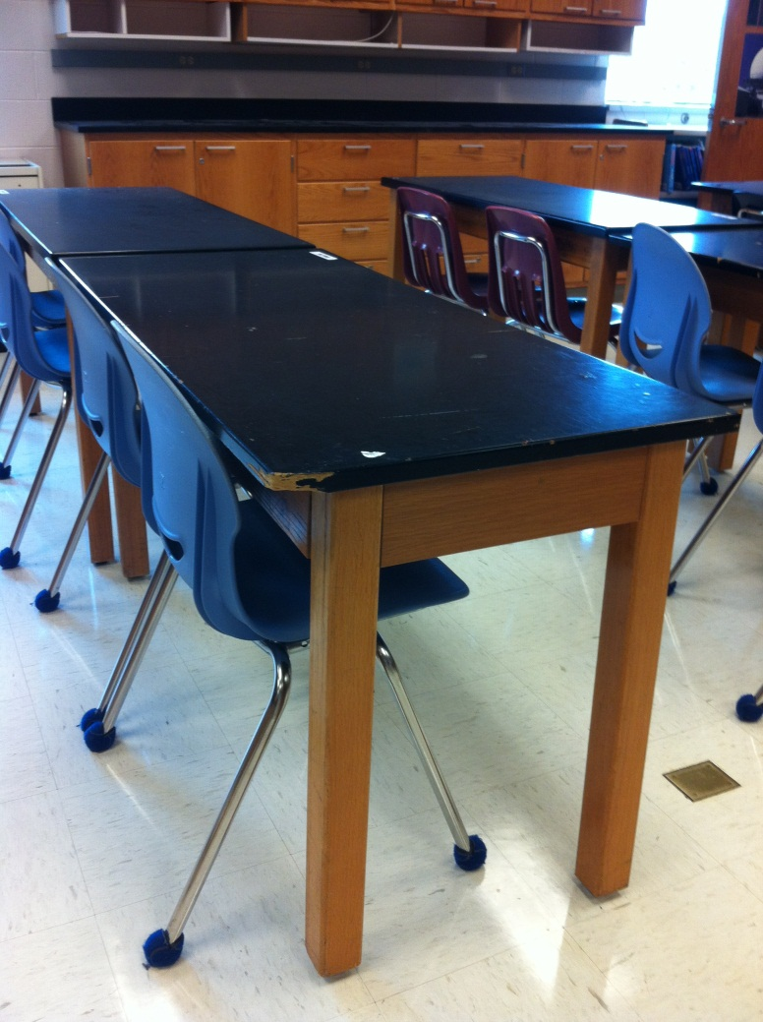
furniture
Contemporary learning space evaluation
WHY
WHAT
HOW
Condition
TABLES
Condition | Elem. | Middle | High
Excellent | 5% | 4% | 8%
Good | 94% | 84% | 88%
Poor | 2% | 11% | 14%
SEATING
Condition | Elem. | Middle | High
Excellent | 10% | 2% | 9%
Good | 80% | 86% | 83%
Poor | 14% | 10% | 14%

Slide 19
furniture
Contemporary learning space evaluation
WHY
WHAT
HOW
Current Furniture Replacement Program
  The replacement cycle for classroom furniture is generally accepted as 15 to 20 years
  The Building Services’ operational budget contains a small amount (~$50,000) to replace furniture, but it is basically used to replace broken pieces.
  There is NOT an adequate funding mechanism for replacement of furniture. It does not allow for large-scale replacement or to account for increasing enrollment.

Slide 20
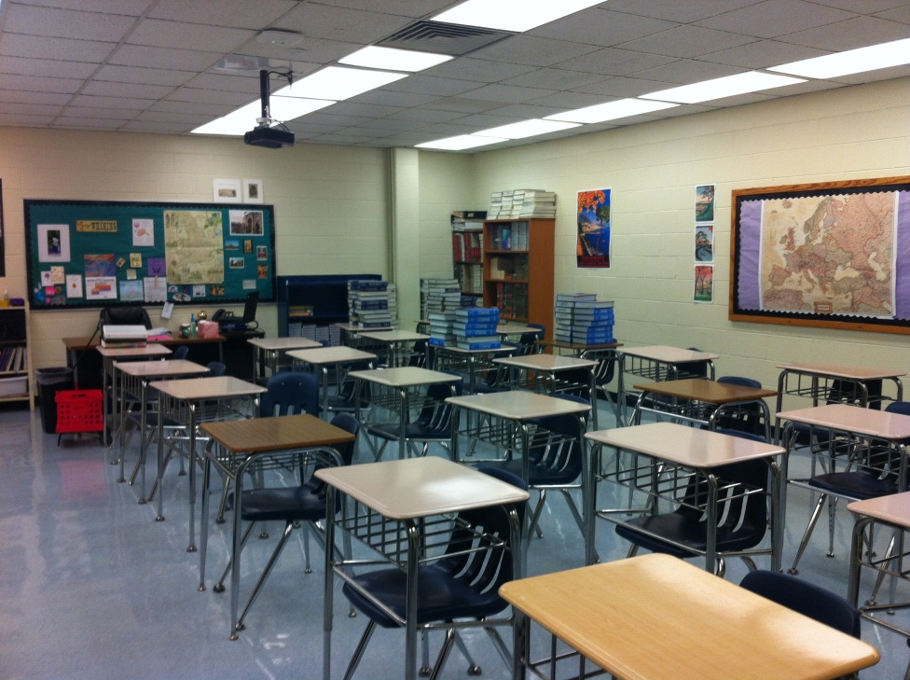
Daylighting
Contemporary learning space evaluation
WHY
WHAT
HOW
Why is it important?
Results:
  ~90 classrooms in the division have no natural light.
Daylight | Elementary | Middle | High
Window | 98% | 76% | 81%
Exterior Door | 34% | 1% | 3%
Skylight | 1% | 0% | 0%
No Natural Light | 2% | 23% | 17%

Slide 21
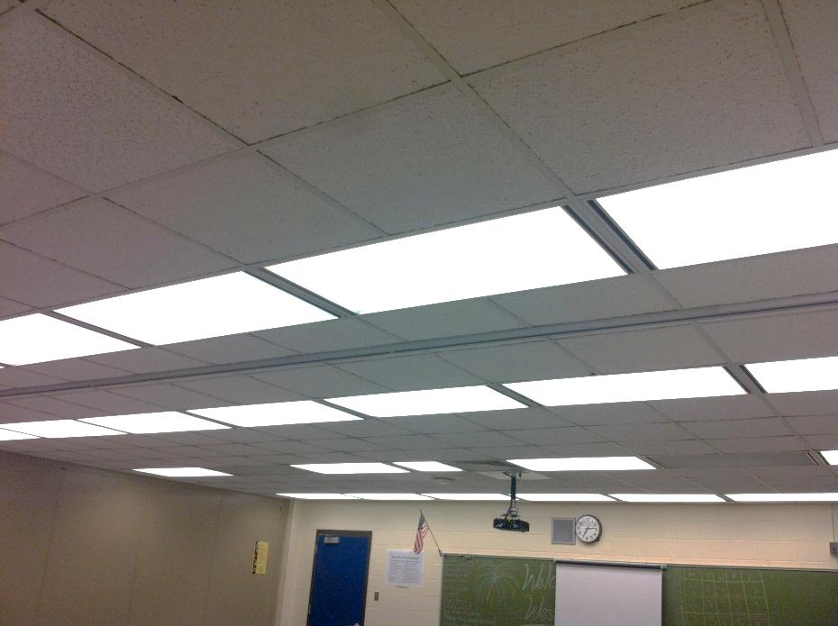
lighting
Contemporary learning space evaluation
WHY
WHAT
HOW
Why is it important?
Results:
Lighting Control | Elementary | Middle | High
Dimmable | 5% | 0% | 5%
Multiple Switches | 48% | 65% | 70%
Minimal (on/off) | 44% | 34% | 24%

Slide 22
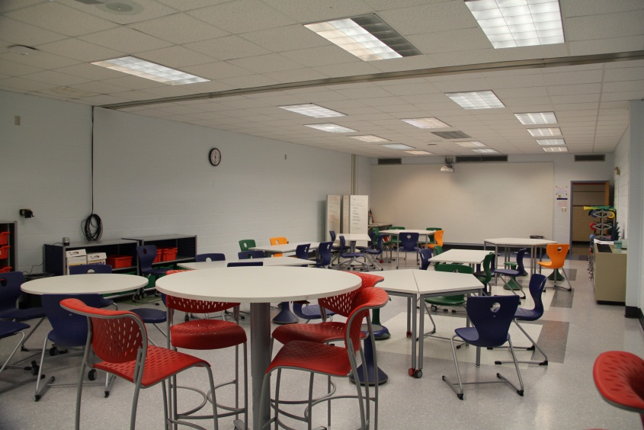
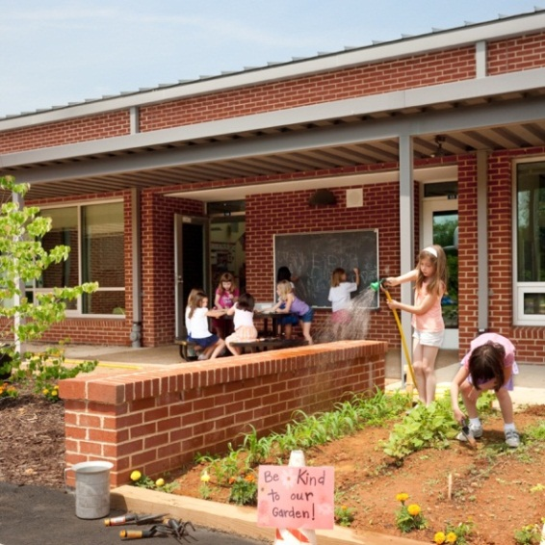
connectivity
Contemporary learning space evaluation
WHY
WHAT
HOW
Why is it important?
Results:
Connection | Elementary | Middle | High
Access to outdoors | 34% | 1% | 3%
Hallway | 0% | 0% | 0%
Adjacent Classrooms | 4% | 3% | 10%

Slide 23
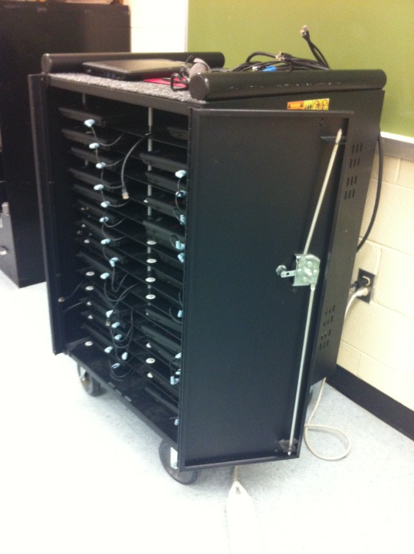
POWER
Contemporary learning space evaluation
WHY
WHAT
HOW
Why is it important?
Results:
Power | Elementary | Middle | High
Access outlets | 96% | 80% | 90%
*Data does not reflect quantity of outlets. This is deficiency throughout the division.

Slide 24
Contemporary learning space evaluation
WHY
WHAT
HOW
Conclusion
  Space has a demonstrated effect on student performance and well-being.
  The division has over 850 classrooms. Less then 30 come close to meeting the criteria evaluated.
  We must be more rigorous in how & when buildings are renovated and updated to ensure instructional spaces are matching are expectations of learners.
Notes:
AHS MESA -2
Brownsville – 10
Greer – 7
Woodbrook -1
Henley -2

Slide 25
Learning space modernization project
WHY
WHAT
HOW
mod·ern·ize verb \ˈmä-dər-ˌnīz\ :
to make (something) modern and more suited to present styles or needs

Slide 26
Learning space modernization project
WHY
WHAT
HOW
CLASSROOM FURNITURE UPGRADE
CLASSROOM MODERNIZATION
MEDIA CENTER RENOVATION
CAFETERIA RENOVATION
SPECIALTY CLASSROOM RENOVATION
Daylighting

Slide 27
Learning space modernization project
WHY
WHAT
HOW
Classroom Furniture Upgrade
Scope: Update furniture to create a flexible & comfortable learning environment. This includes ergonomic seating choice, work surfaces that vary in height & size but are all mobile, & adequate storage.
Budget: $15,000/room
Sample Breakdown:
FURNITURE
Ergonomic Seating | 24 | $150 | $3,600
Flexible Tables | 5 | $500 | $2,500
Adjustable Height Tables | 2 | $1,200 | $2,400
Mobile Whiteboards | 3 | $500 | $1,500
Mobile Storage | 2 | $1,500 | $3,000
Soft Seating | 1 | $2,000 | $2,000
Total |  |  | $15,000

Slide 28
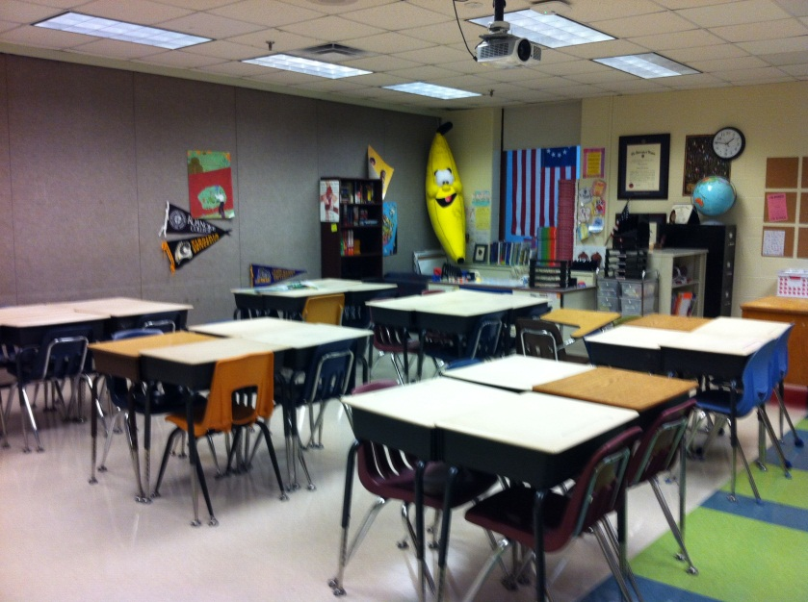
Learning space modernization project
WHY
WHAT
HOW
Classroom Modernization
Scope: Renovate classroom spaces to update all finishes, casework, & lighting. Improve transparency & connection to adjacent spaces, including the outdoors if feasible.
Budget: $50,000/room (will vary +/- depending on room)
Example of classroom in need of modernization

Slide 29
Learning space modernization project
WHY
WHAT
HOW
Classroom Modernization
Sample Breakdown:
CONNECTIVITY
Add access to outdoors | $5,000
Create operable opening to adjacent room | $7,500
Create operable opening to hallway | $15,000
UTILITIES/INFRASTRUCTURE
New LED Lights and controls | $5,500
Electrical power & tech. | $3,500
OTHER
New flooring and base | $3,000
New ceilings | $3,000
New cabinets and counters | $3,500
Patch, paint, caulk | $1,500
Whiteboards and/or whiteboard paint | $1,000
New shades | $500
Misc. | $1,000
Classroom Modernization Total | $50,000
FURNITURE
Ergonomic Seating | 24 | $150 | $3,600
Flexible Tables | 5 | $500 | $2,500
Adjustable Height Tables | 2 | $1,200 | $2,400
Mobile Whiteboards | 3 | $500 | $1,500
Mobile Storage | 2 | $1,500 | $3,000
Soft Seating | 1 | $2,000 | $2,000
Total |  |  | $15,000

Slide 30
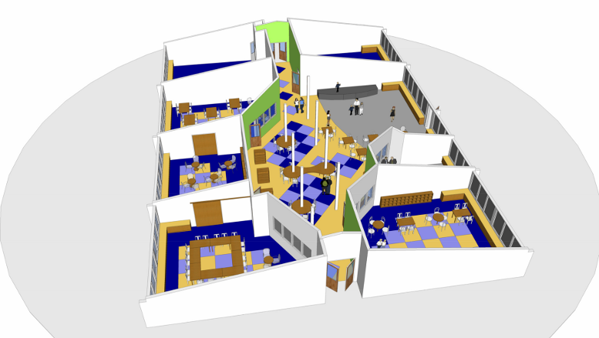
Learning space modernization project
WHY
WHAT
HOW
Classroom Modernization
Example: Forest Avenue Elementary School, Middletown Rhode Island
Pictures: www.fieldingair.com

Slide 31
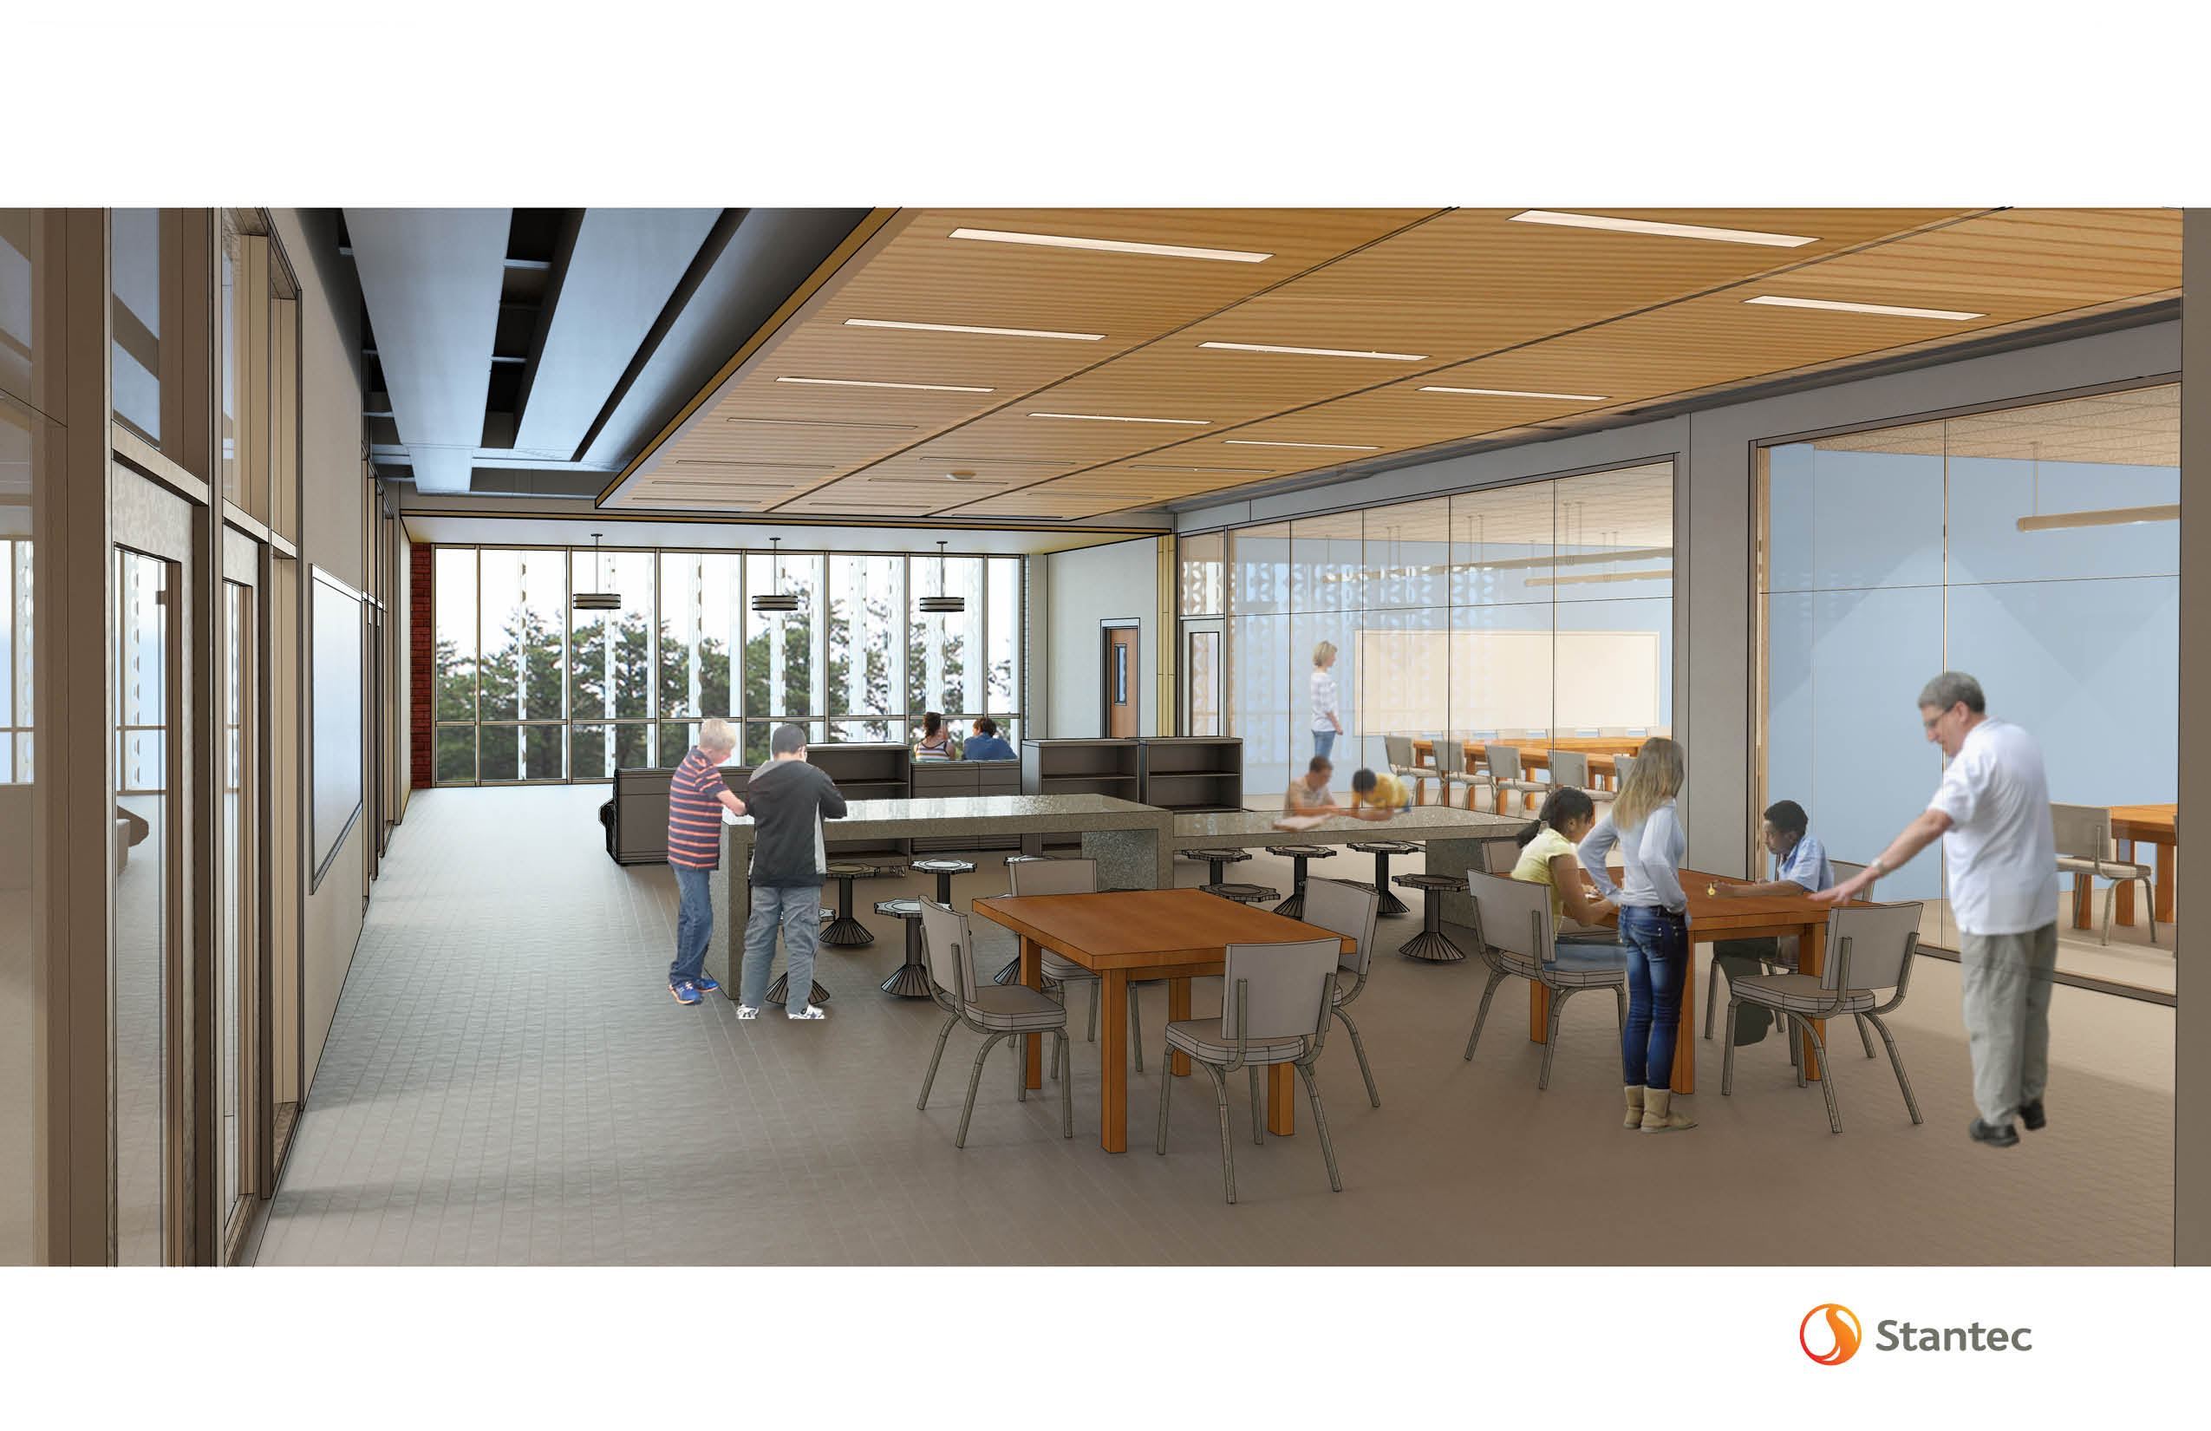
Learning space modernization project
WHY
WHAT
HOW
Classroom Modernization
Example: Fredrick County Middle School

Slide 32
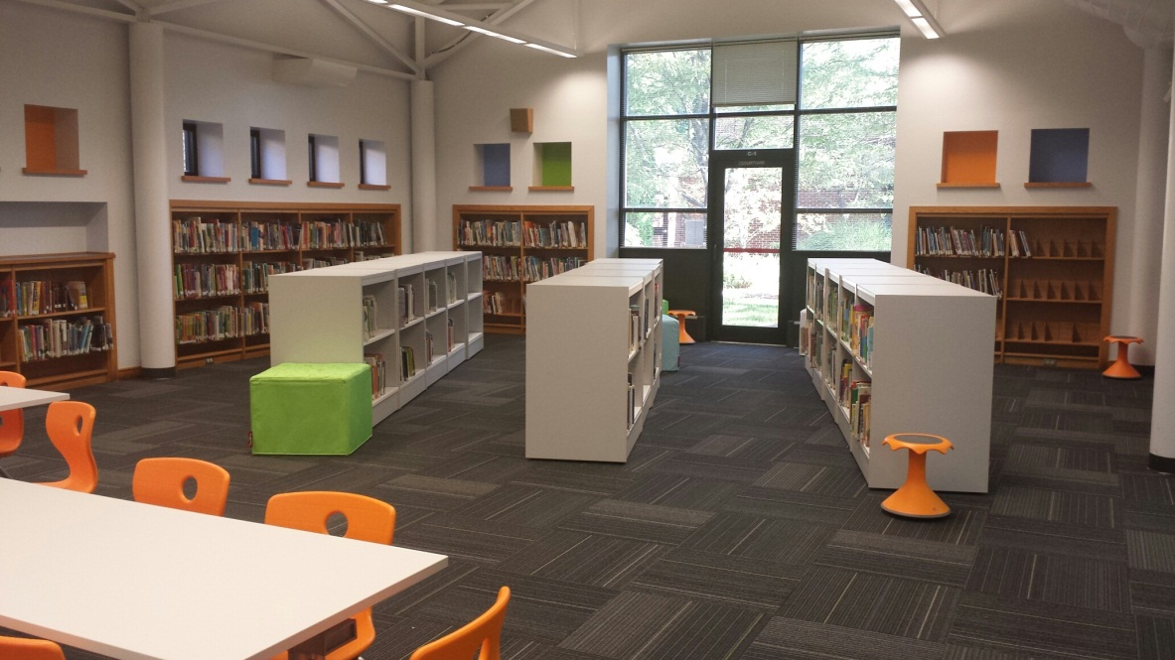
Learning space modernization project
WHY
WHAT
HOW
Media Center Renovation
Scope: Renovate media centers to be flexible hubs of congregation, collaboration, & creation. This includes updating furniture, shelving, and accessory spaces.
Budget: $125,000/space
Hollymead Media Center, Design 2015 Renovation

Slide 33
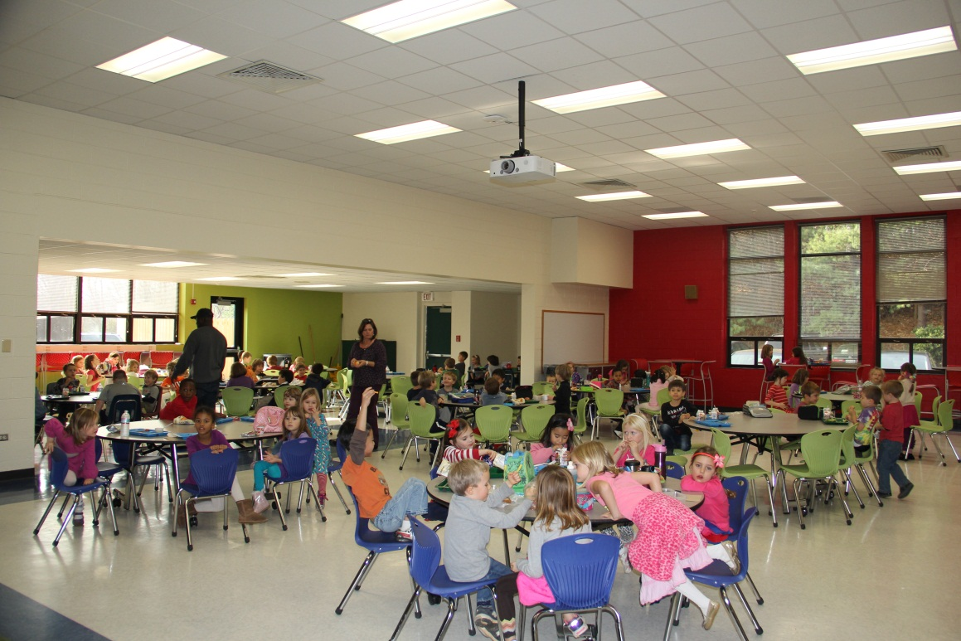
Learning space modernization project
WHY
WHAT
HOW
Cafeteria Renovation
Scope: Update cafeteria finishes & furniture.
Budget: $125,000/space
Murray Elementary Cafeteria, Design 2015 Renovation

Slide 34
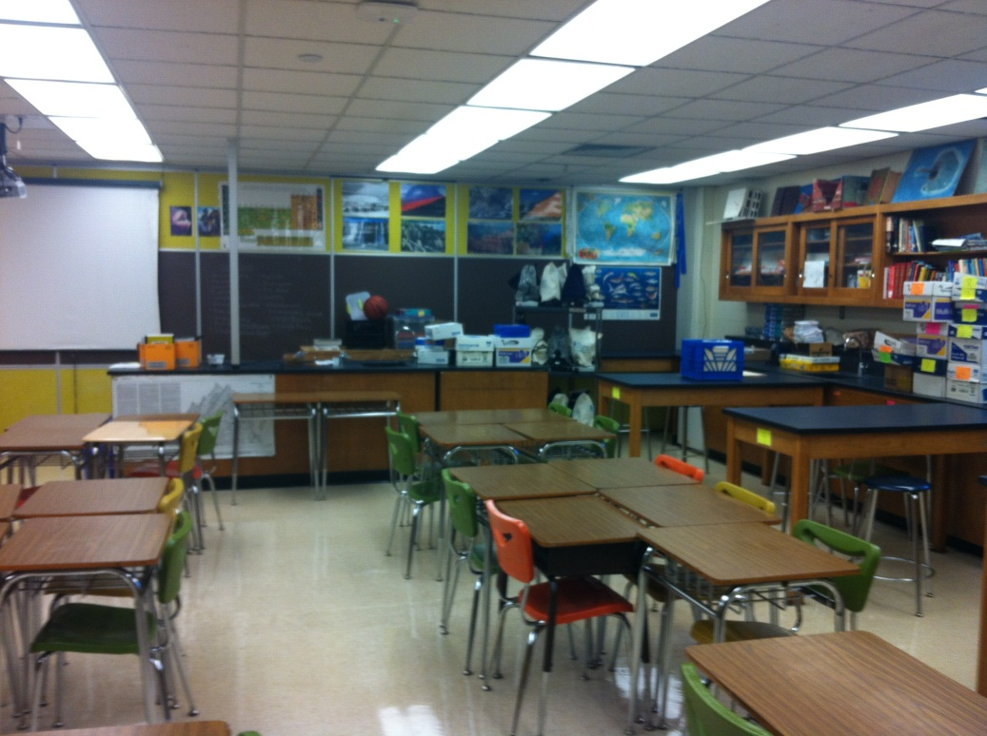
Learning space modernization project
WHY
WHAT
HOW
Specialty Classroom Renovation
Scope: Renovate existing spaces to create state-of-the-art science labs, music, art, CTE & other specialty rooms. Create dedicated maker spaces.
Budget: $50,000/room
Western Albemarle
Science Room

Slide 35
Learning space modernization project
WHY
WHAT
HOW
 | Western (1)
 | Henley (2)
 | Jouett (4)
 | Walton (4)
 | Sutherland (6)
 | Burley (6)
Monticello (1)
Western (1)
Jouett (2)
 |  |  |  | Albemarle (4)
Albemarle (4)
 | Monticello (8)
 |  |  |  | Western (6)
Henley (5)
 |  | Albemarle(3)
1-10 | 11-20 | 21-30 | 31-40 | 41-50
Age of Science Rooms
# of Years

Slide 36
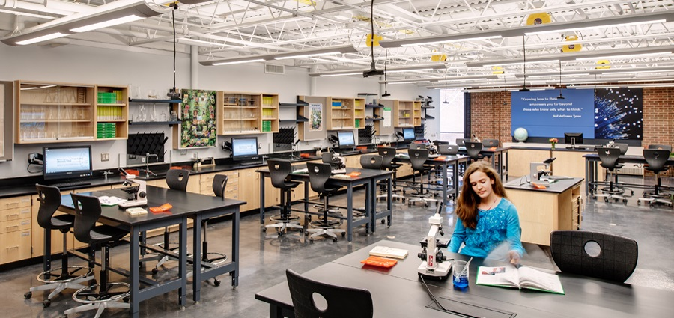
Learning space modernization project
WHY
WHAT
HOW
Specialty Classroom Renovation
Example: Buford Engineering Design Academy by VMDO Architects

Slide 37
Learning space modernization project
WHY
WHAT
HOW
10 Year Phasing Plan
If funded, a follow–up meeting would discuss a specific school by school phasing plan
Guiding Principles of Phasing Plan:
  Plan would not complete a whole school before moving onto the next.
  Work at larger schools would be completed in 2 year cycle to allow for a year of evaluation.
  At least one portion of ALL schools will be modernized in the first 5 years.

Slide 38
Learning space modernization project
WHY
WHAT
HOW
Estimated Overall Budget
Scope | Price/Room |  | # of Rooms | Total
Classroom Furniture Upgrade | $15,000 |  | 781 | $11,715,000
Classroom Modernization | $50,000 |  | 725 | $36,250,000
Specialty Classroom Renovation: Art | $50,000 |  | 25 | $1,250,000
Specialty Classroom Renovation: CTE | $50,000 |  | 31 | $1,550,000
Specialty Classroom Renovation: Music | $25,000 |  | 32 | $800,000
Media Center Renovation | $125,000 |  | 17 | $2,125,000
Cafeteria Renovation | $125,000 |  | 16.5 | $2,062,500
Daylighting | $10,000 |  | 80 | $800,000
 |  |  | Subtotal: $56,552,500
 |  |  | Design/PM Fees: $5,655,250
 |  |  | Contingency (10%): $5,655,250
 |  |  | Total: $67,863,000

Slide 39
Learning space modernization project
WHY
WHAT
HOW
Questions/Discussion

